Slide 1
Unit-5
Cloud Database
Part-2

Slide 2
Contents
Cloud Database- Operational Model for Cloud Database, Types of Cloud Database
Cloud File System- Distributed File System Basics, Concept of GFS and HDFS, Comparison of Features

Slide 3
Cloud Database
A cloud database is a database service built and accessed through a cloud platform. It serves many of the same functions as a traditional database with the added flexibility of cloud computing.
Key features:
A database service built and accessed through a cloud platform
Enables enterprise users to host databases without buying dedicated hardware.
There are some SQL-based and some NoSQL- based databases offering.
Accessed through a web interface or vendor-provided API.

Slide 4
Operation Model for Cloud Database
There are two primary methods to run a database on a cloud platform:
Virtual Machine image: Cloud platforms allow users to purchase virtual-machine instances for a limited time, and one can run a database on such virtual machines. Users can either upload their own machine image with a database installed on it, or use ready-made machine images that already include an optimized installation of a database.
Database-as-a-service (DBaaS): With a database as a service model, users pay fees to a cloud provider for services and computing resources, reducing the amount of money and effort needed to develop and manage databases.Users are given tools to create and manage database instances, and control users. Some cloud providers also offer tools to manage database structures and data. Many cloud providers offer both relational (Amazon RDS, SQL Server) and NoSQL (MongoDB, Amazon DynamoDB) databases. This is a type of software as a service (SaaS).

Slide 5
Architectural and common Characteristics
Fast Deployment: Cloud databases are the perfect choice when you urgently need a database, as they can be up and running in minutes. Cloud databases eliminate the need to purchase and install hardware and set up a network.
Accessibility: Users have quick access to cloud databases remotely through the provider's API or web interface.
Scalability: You can expand cloud database storage capacity without disruptions and meet the requirements. Cloud database scalability is seamless due to DBaaS implementation, which is a major benefit for growing businesses with limited resources.
Disaster Recovery: Data backups are regularly performed on cloud databases and kept on remote servers. These backups enable a business to stay online in cases of natural disasters, equipment failure, etc.

Slide 6
Lower Hardware Costs: Cloud database service providers supply the infrastructure and perform database maintenance. Hence, companies invest less in hardware and have fewer IT engineers for database maintenance.
Value for Money: Many DBaaS solutions are available in multiple configurations, allowing companies only to pay for what they use and turn off services when they don't need them. Cloud databases also save money by not requiring operational costs or expensive upgrades.
Latest Tech: Cloud database providers upgrade infrastructure and keep it updated with new tech. This brings significant savings as companies don't have to allocate funds on new tech or staff training.
Security: Most cloud database providers encrypt data and invest in the best cloud security solutions to keep the databases safe. Since cloud database providers use automation to enforce the best security practices, there is less room for human error compared to using on-premises databases.

Slide 7
Cloud Database Vendors
Microsoft Azure
Amazon Web Service (AWS)
Oracle
Google Cloud
Rackspace

Slide 8
Types of Cloud database
It is also important to differentiate between cloud databases that are relational as opposed to non-relational or NoSQL.
The details of each type of cloud database are discussed in the following subsections:
Cloud Relational Databases
Cloud NoSQL Databases

Slide 9
Cloud Relational Database
Microsoft Azure: Microsoft Azure cloud database is one of the most popular and globally widespread cloud platforms. It offers computing, networking, databases, analytics, AI, and IoT services. The public cloud computing platform from Microsoft offers various solutions, including Infrastructure as a Service (IaaS), Platform as a Serice (PaaS), and Software as a Service (SaaS).

Slide 10
Amazon Web Service (AWS): AWS is one of the market leaders when it comes to DBaaS. Amazon offers various services for data management and integration. Some of AWS database solutions are:
Amazon RDS. Amazon Relational Database Service runs on either Oracle, SQL, or MySQL server instances.
Amazon SimpleDB. Designed for smaller workloads, SimpleDB is primarily a schema-less database.
Amazon DynamoDB. DynamoDB is a NoSQL database capable of automatically replicating workloads across three availability zones.
The downside is that scaling and patching operations require downtime.

Slide 11
Google Cloud: Google Cloud Platform (GCP) offers various services that use the same hardware and infrastructure as other Google products. GCP's offer includes a wide range of hosted services for cloud computing, storage, networking, big data, machine learning, IoT, cloud management, etc.
GCP provides IaaS, PaaS, and serverless computing environments.
One of the products in Google Cloud Platform is Cloud Datastore, a database storage solution for NoSQL non-relational storage.
Other Google Cloud products are Cloud SQL for MySQL fully relational storage and Google's native Cloud Bigtable database.
The downside is a lack of managed services and the high prices, including a costly support fee.

Slide 12
Oracle: Oracle offers enterprise-scale cloud database technology to its users. The database solution uses machine learning to automate database management, ensuring high performance, reliability, and security.
Oracle cloud database covers hyper-scale Big Data and Streaming workloads, including OLTP, data warehousing stack, Spark, text search, image analytics, and data catalog.
The different solutions offered are Infrastructure as a Service (IaaS), Platform as a Service (PaaS), Software as a Service (SaaS), and Data as a Service (DaaS).
The downside is a lack of integration with other cloud solutions.

Slide 13
IBM Db2 on Cloud: IBM Db2 on Cloud is a fully managed SQL database featuring a 99.99% uptime SLA, independent storage and compute scaling through UI and API, several disaster-recovery options, data encryption, and other features.
IBM's relational database offers advanced data management and analytic capabilities for transactional and warehousing workloads. This database delivers high performance, boasts great insights, data availability, reliability, and broad operating system support.
The downside of IBM Db2 is that it has fewer regional options, affecting performance in some cases.

Slide 14
Rackspace: Rackspace offers scalable, fully managed, or hosted cloud databases, characterized by high performance and a storage area network (SAN) based on the OpenStack platform.
Rackspace offers easy access to your cloud database via Cloud Control Panel, CLI or API, and features regular backups of all cloud databases.
Redundant storage and synchronous data replication ensure data protection in case of disaster or hardware failure.
The downside is a smaller number of data centers compared to the competition.

Slide 15
Cloud NoSQL Databases
NoSQL database is “ not only SQL” database.
The evolution of NoSQL database started in early 2009 and has been growing rapidly since because of some limitations with relational databases.
NoSQL database is categorized as non-relational database.
There are certain limitations with our traditional database system and they cannot fit into the current scenario of big data related applications because data is growing exponentially in every industry
Traditional databases are not capable of handling such that are growth which is now the TeraByte and PetaByte.

Slide 16
Types of NoSQL Database
Key value store – Based on table keys and values. (AWS DynamoDB)
Document based store - Document based database to records that are made of Tagged elements (eg mongo DB)
Column based store - Data divided into multiple columns and every storage block contains data of each column (e.g. Apache Hbase, Cassandra)
Graph based store - A network graph storage that uses edges and nodes for storing data (e.g. Neo 4j)

Slide 17
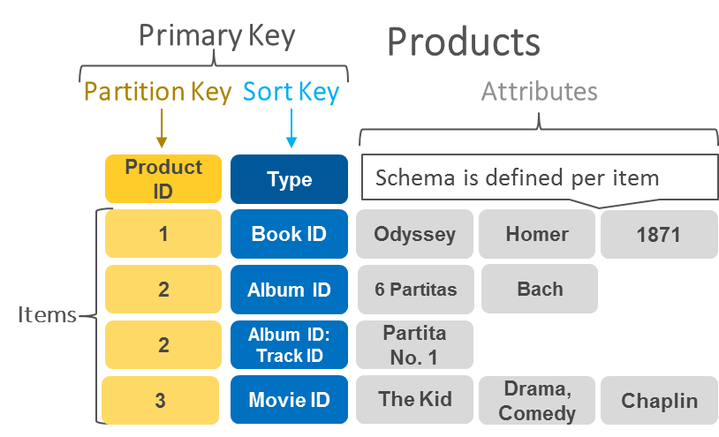
Key Value Pair

Slide 18
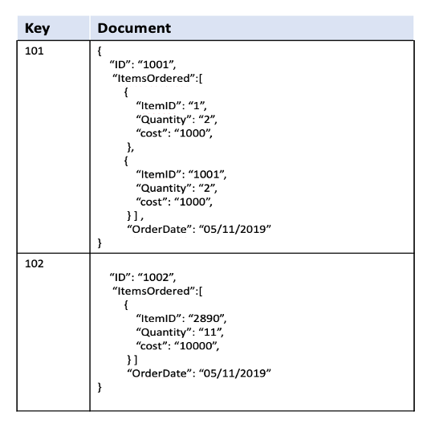
Document based store

Slide 19
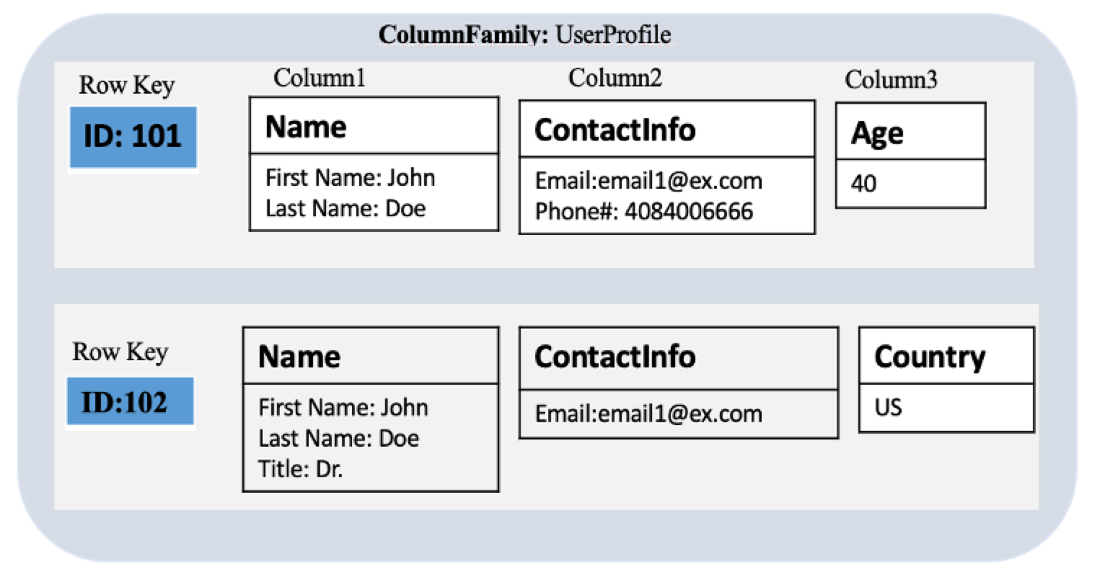
Column based datastore

Slide 20
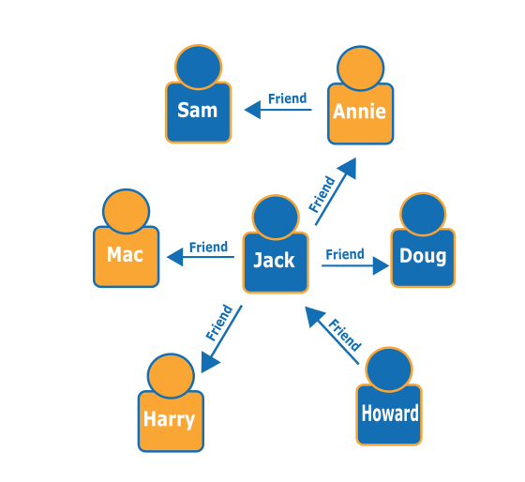
Graph based Store

Slide 21
Most popular and widely adopted NoSQL Database
MongoDB is one of the most popular and fast growing NoSQL database.
Managed easily on cloud infrastructure.
MongoDB is open source document database.
Using MongoDb search queries can be done by fields, range queries and regular expressions.

Slide 22
Amazon DynamoDB - DynamoDB is one of the most popular no SQL database of the Amazon which is based on the key value data store. It was first developed for an internal purpose like handling customer related big data applications.
It is built on the top of a single solid state device architecture therefore it scales according to the data in the system .
It provides very high quality reliable throughput and single digit millisecond latency which is preferred in building fast gaming and analytics based applications

Slide 23
Dynamic cassandra - It delivers first performance high availability and scalability with dynamic schema.
It is designed specifically for handling real time Data Analytics related high workload without a single point of failure.
It offers high data availability and quick scalability to many Enterprises.

Slide 24
CouchDB- CouchDB NoSQL database is completely web oriented.
It stores the data in javascript Object Notation document format which can be accessed using JSON API.
It work for all types of web and mobile apps.

Slide 25
Apache HBase- Apache hbase is mostly used in Hadoop related projects.
HBase is another subproject of Apache Foundation which is strongly associated with the Hadoop ecosystem.
It is used to write and update data in real time and can be placed as a traditional database.
HBase also provides various API which supports many operations using application programming languages.

Slide 26
Neo 4J- It is most popular graph Database used in various mission-critical applications. It is the preferred choice of many startups and midsize Organisation across the globe.
It's highly robust and scalable database comprises ACID properties.
Because it provides high availability clustering with a graph query language the customer can easily import the data into CSV format it also supports advanced monitoring.

Slide 27
Cloud File Systems
Distributed file system is basically used for storing huge will amount of data and provide accessibility of store data to all the distributed client across the network.
The objective of the DFS is to provide a system for all the geographical distributed user as a common file system for data sharing and storage
DFS comprises various software component that run as a single system entity on multiple systems. An internet search engine is one of the most common example of DFS, which is used for indexing millions of web pages.

Slide 28
Some popular file systems are:-
Andrew file system
Network file system (oldest file system)
Coda
Microsoft distributed file system
Apple filing protocol
Google file system
Hadoop distributed file system

Slide 29
Concept of GFS (Google file system)
Google invented and implemented a scalable dfs to handle their huge internal Distributed Data exhaustive applications and named it as a Google file system.
In 2002 and 2003, Google launched its file system based on dfs architecture but added some advanced feature that are driven by Google unique workload and environment.

Slide 30
Details of components of GFS
Chunks – A chunk is very similar to concept of block in a file system, but junk size is larger than the traditional file system block. The block of chunk is 64 MB. This is specifically designed for Google environment.
Master -Master is a single process that run on entirely separate machine for security purpose. It only stores metadata related information, Chunk location, file mapping information and access control information. The client first contact the master for information about meta data and then connects to that particular chunk server.

Slide 31
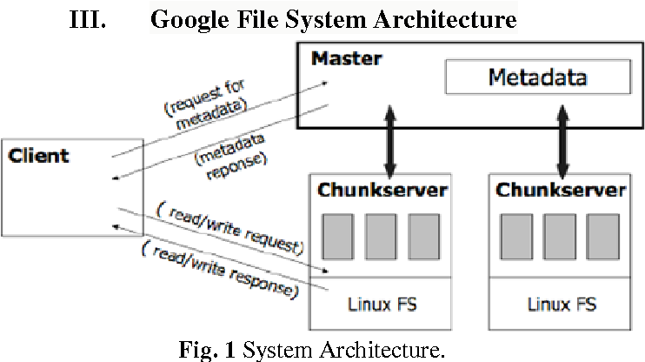
Metadata - is stored in the memory of a master, therefore Master operations are much faster.
Metadata contains three type of information:
Namespaces of file and chunk
location of each chunk
Mapping from file to chunk from

Slide 32
HDFS
Hdfs is a dfs based on gfs that provides high throughput access to application data.
It uses the commodity hardware with the expectation that failure will occur and provide portability across heterogeneous hardware and software platforms
Hdfs is acquired by Hadoop Apache open source project which is very popular these days for its ability to handle big data.

Slide 33
The hadoop-core consists of two modules:
Hadoop distributed file system: Used for storing huge amount of data.
MapReduce programming mode: Used for processing of large set of data.

Slide 34
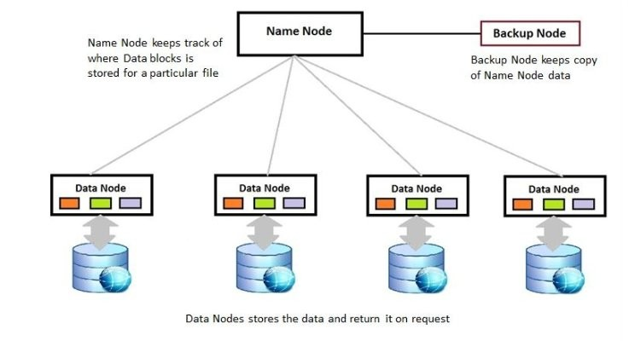
Architecture of HDFS Apache Hadoop Distributed File System
An HDFS cluster consists of multiple commodity machines that can be classified into the following three types:
Name node (runs on master machine)
Secondary name node or backup node (runs on separate machine)
Data node (runs on slave machine)
Here the master is the name node that contains the meta data of the cluster but the processing occurs through the data nodes.
The client first connect to the metadata and receive information about the data node and the next time directly connect to the data node.

Slide 35
Features of HDFS Apache Hadoop Distributed File System
Durability
Placement Policy
Load balancing
Data integrity

Slide 36
Apache Hadoop
Apache Hadoop is a collection of open-source software utilities that facilitates using a network of many computers to solve problems involving massive amounts of data and computation. It provides a software framework for distributed storage and processing of big data using the MapReduce programming model.

Slide 37
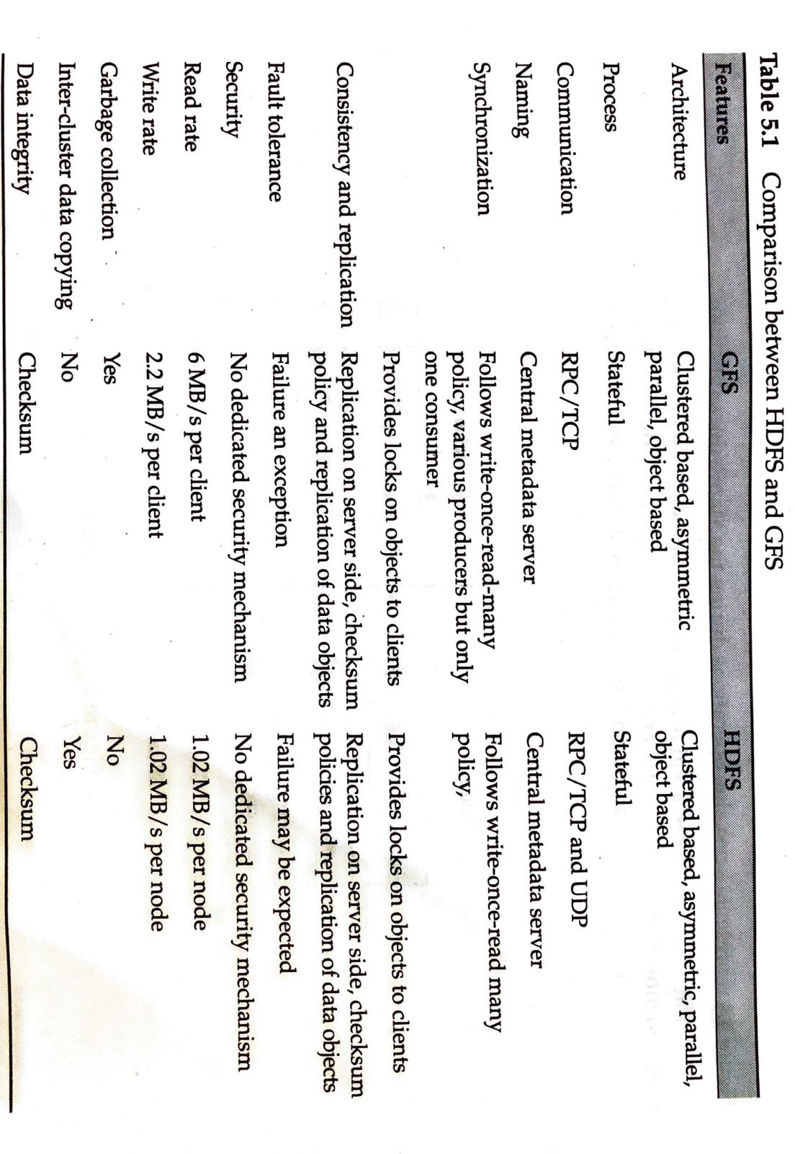

Slide 38
1. What is the typical use case for Google File System (GFS)?
Real-time video streaming
Storing and processing large files like log data
Hosting web applications
Email communication

Slide 39
2. What is the primary purpose of Google File System (GFS) and Hadoop Distributed File System (HDFS)?
Real-time data processing
High-performance computing
Distributed storage and data processing
Data encryption and security

Slide 40
3. Hadoop Distributed File System (HDFS) uses a master-slave architecture. What is the name of the master node in HDFS?
JobTracker B) NameNode C) DataNode
D) ResourceManager

Slide 41
4. In Hadoop Distributed File System (HDFS), data blocks are replicated across multiple DataNodes. What is the default replication factor in HDFS?
1
2
3
4

Slide 42
5. Which of the following best describes the primary use case for GFS and HDFS, respectively?
GFS is used for large-scale data analytics, while HDFS is used for web content storage.
GFS is used for web content storage, while HDFS is used for large-scale data analytics.
Both GFS and HDFS are commonly used for scientific simulations.
GFS is optimized for online transaction processing, while HDFS is designed for online analytical processing.

